Slide 1
Platforms
Lecture 5A: Assembly Language Programming

Slide 2
Data Transfer Introduction
ARM has 3 classes of data transfer instructions:
Single register swap instructions, i.e. MOV and MVN, which were covered in Lecture 4B
Single register load and store instructions, which will be covered in this lecture
Multiple register load and store instructions, which will be covered in the next lecture.
The load instruction is LDR (Load into Register)
The store instruction is STR (Store from Register).

Slide 3
Register-Indirect Addressing
To load a value from memory into a register using this mode, use a second register, known as the base register.
This base register holds the actual memory address that the program is interested in.
The LDR instruction:
inspects the base register,
interprets its value as the memory address,
fetches the value stored at that memory location
and then loads it into a destination register.

Slide 4
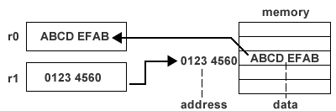
Register-Indirect Addressing
LDR r0, [r1] ; r0 receives the value held at the ; the memory address pointed to by r1
; r0 is the destination register,
; r1 is the base register

Slide 5
Register-Indirect Addressing
In storing a value to memory from a register, a base register holds the actual memory address.
The STR instruction:
inspects the base register,
interprets its value as a memory address location,
and places the value held in the source register into the memory location.
STR r0, [r1] ; the memory location pointed to by ; r1 receives the value held in r0
(r0 is the source register, r1 is the base register)

Slide 6
PC-Relative Addressing
How can a 32-bit memory address be loaded into a register in the first place?
A MOV instruction will not do the job:
all ARM instructions are 32 bits long. Some bits are for the opcode, others for the destination register, leaving fewer than 32 bits left for a literal number.
ARM uses a special instruction, known as a pseudo-instruction, that does not actually exist.
the assembler translates the pseudo-instruction (e.g. ADR) into one or more real instructions.
ADR loads an address into a destination register.

Slide 7
PC-Relative Addressing
copycode ADR r1, SRCDATA ; the value of r1 points to the ; SRCDATA location in memory
ADR r2, DESTDATA ; the value of r2 points to the ; DESTDATA location in memory
LDR r0, [r1] ; load value at memory location ; pointed to by r1 into r0 (SRCDATA)
STR r0, [r2] ; store value in r0 to memory ; location pointed to by r2 ; (DESTDATA)
...
SRCDATA ... ; source of data
...
DESTDATA ... ; destination for the data

Slide 8
PC-Relative Addressing
In most cases, the current value of the Program Counter (r15) will normally be "close" to the intended memory address location.
An ADR instruction is translated into one or more instructions that can add a constant value to or subtract a constant value from the current value of the Program Counter and place the result in the destination register specified by the original ADR instruction.

Slide 9
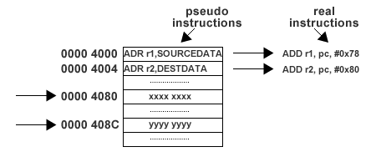
PC-Relative Addressing
The constant value is known as the PC-relative offset.
It can be calculated by the formula below:
PC-relative offset = desired address - (Program Counter value + 8)

Slide 10
Pre-indexed Addressing
copy ADR r1, SRCDATA ; value of r1 points to SRCDATA
ADR r2, DESTDATA ; value of r2 points to DESTDATA
LDR r0, [r1] ; load value at location pointed to by r1 into r0 (SRCDATA)
STR r0, [r2] ; store value in r0 to location pointed to by r2 (DESTDATA)
ADD r1, r1, #4 ; step r1's value to next word location
ADD r2, r2, #4 ; step r2's value to next word location
LDR r0, [r1] ; load value at new location pointed to by r1 into r0
STR r0, [r2] ; store value in r0 to new location pointed to by r2
SRCDATA ; source of data
..
DESTDATA ; destination for the data

Slide 11
Pre-indexed Addressing
Pre-indexed addressing mode provides a means of simplifying the process by eliminating the ADD instructions.
LDR r0, [r1, #4] ; load r0 with the value found ; at the memory location whose ; address is value of r1 + 4
r1 contains the base address and #4 is the offset.
The sum of the base address and the offset yields the effective address.

Slide 12
Pre-indexed Addressing
copycode ADR r1, SRCDATA ; the value of r1 points to the SRCDATA location ; in memory
ADR r2, DESTDATA ; the value of r2 points to the DESTDATA ; location in memory
LDR r0, [r1] ; load value at memory location pointed to by r1 ; into r0 (SRCDATA)
STR r0, [r2] ; store value in r0 to memory location pointed to ; by r2 (DESTDATA)
LDR r0, [r1, #4] ; load value at new memory location pointed to ; by the effective address of r1+4
STR r0, [r2, #4] ; store value in r0 to new memory location ; pointed to by the effective address of r2+4
.
SRCDATA ; source of data
..
DESTDATA ; destination for the data

Slide 13
Pre-indexed Addressing
In pre-indexed addressing, the base address register (e.g. r1 and r2) are not modified.
The base address register can be updated to point to the new address. This is pre-indexed addressing with auto-indexing:
LDR r0, [r1, #4]! ; load value at location pointed to ; by the effective address of r1+4. ; Increment r1 (i.e. r1 := r1 +4)
The "!" suffix on the effective address indicates that the base register should be incremented after the data transfer.

Slide 14
Post-indexed Addressing
In post-indexed addressing, the base address stored in the base register is used directly as the effective address. The base register is then auto-indexed to point to the next memory location.
Post-indexed addressing is always auto-indexing.
LDR r0, [r1], #4 ; load value at memory location ; pointed to by r1. Increment r1 ; such that r1:= r1 +4

Slide 15
Post-indexed Addressing
copycode ADR r1, SOURCEDATA ; value of r1 points to SRCDATA location in ; memory
ADR r2, DESTDATA ; value of r2 points to DESTDATA memory location
loop LDR r0, [r1], #4 ; load value at memory location pointed to by r1 into r0. ; Increment r1
STR r0, [r2], #4 ; store value in r0 to memory location pointed to by r2. ; Increment r2
... ; decide if more data is available and if so branch to loop
SRCDATA ; source of data
DESTDATA ; destination for the data

Slide 16
Byte Load and Store
LDR and STR instructions transfer full words not individual bytes.
The LDRB and STRB instructions transfer bytes
LDRB r0, [r1] ; load r0 with the byte at ; memory location pointed to by r1
STRB r0, [r1] ; store the byte held in r0 into ; the memory location pointed to ; by r1

Slide 17
Byte Load and Store
Which byte is transferred by LDRB?
If the address is word aligned, bits 0 to 7 are loaded into the destination register.
If the address is word aligned plus one byte, bits 8 to 15 are loaded into the destination register, etc.
The chosen bits are loaded into the bottom 8 bits of the destination register (all other bits are zeroed).
In STRB transfer, the bottom 8 bits of the source register are repeated across the entire word as it is sent over the data bus. It is the responsibility of the external memory hardware to ensure that the correct byte is updated.

Slide 18
Shift and Rotate Introduction
A shift operation moves the bits in a register to the left or right and fills the vacant holes with zeros or ones.
Shifting bits left by one bit is equivalent to multiplying the original number by 2.
Shifting bits right is equivalent to division.
Thus shift operations can simulate certain forms of integer multiplication and division.

Slide 19
Shift and Rotate Introduction
Why not use generic multiply and divide instructions?
Firstly the ARM, like many processors, does not have an integer division instruction.
Secondly generic multiplication and division is a slow process - faster to use shift operations.
In most processors, shift and rotate instructions are distinct instructions.
In ARMs, shift and rotate are special operands that can be applied to one of the register operands of any data processing instruction.

Slide 20
Shift and Rotate Introduction
A shift or a rotate can be performed at the same time as an ADD or a MOV instruction because the ARM has a "barrel shifter" in its ALU
Shift and rotate operands can be applied to:
ADC, ADD, AND, BIC, CMN, CMP, EOR, MOV, MVN, ORR, RSB, SBC, SUB, TEQ, TST.
Shift and rotate operands can also be applied to registers used for calculating addresses in LDR and STR instructions.

Slide 21
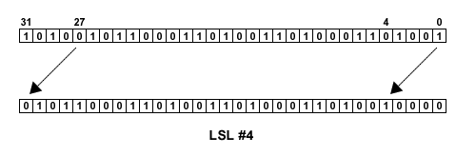
Logical Shift Operations
LSL is a logical shift left by 0 to 31 places.
The vacated bits at the least significant end of the word are filled with zeros.

Slide 22
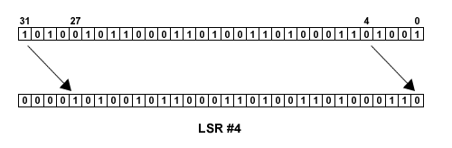
Logical Shift Operations
LSR is a logical shift right by 0 to 32 places.
The vacated bits at the most significant end of the word are filled with zeros.

Slide 23
Logical Shift Operations
Consider the following ARM instruction with r1 = 3 and r2 = 5
ADD r0, r1, r2 ; r0 := r1 + r2 which is r0 := 3 + 5 = 8
Now try the same instruction with a LSL operand, say LSL #3 (logical shift left 3 places which is equivalent to multiplying by 8 (2^3)):
ADD r0, r1, r2, LSL #3 ; r0 := r1 + (8 x r2) ; which is r0:= 3 +(8x5) =43

Slide 24
Logical Shift Operations
Values of LSLs or LSRs need not be literals.
They can be sourced from a register (but must be in the ranges 0 to 31 or 0 to 32 respectively).
Consider a MOV instruction with r1 = 168 and r2 = 3:
MOV r0, r1, LSR r2 ; shift binary value of 168 3 ; places to the right, r0 :=21
(168 = 0000 0000 0000 0000 0000 0000 1010 1000)
(shifted 0000 0000 0000 0000 0000 0000 0001 0101)
For positive numbers, LSR 3 is the same as dividing by 2 ^ 3 (8).

Slide 25
Arithmetic Shift Operations
ASL is an arithmetic shift left by 0 to 31 places.
The vacated bits at the least significant end of the word are filled with zeros. (Same as LSL)
MOV r0, r1, ASL #3 ; shift value in r1 3 places left ; fill in vacant slots with 0's
MOV r0, r1, ASL r2 ; shift value in r1 by number ; of places given in r2 and fill ; in vacant slots with 0's

Slide 26
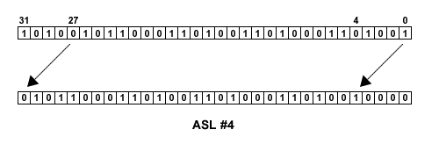
Arithmetic Shift Operations

Slide 27
Arithmetic Shift Operations
ASR is an arithmetic shift right by 0 to 32 places.
The vacated bits at the most significant end of the word are filled with 0's if the original value (the source operand) was positive.
The vacated bits are filled with 1's if the original value was negative.
Known as "sign extending" because the most significant bit of the original value is the sign bit for 2's complement numbers, i.e. 0 for positive and 1 for negative numbers.
Arithmetic shifting therefore preserves the sign of numbers

Slide 28
Arithmetic Shift Operations
MOV r0, r1, ASR #3
; shift value in r1 3 places right and fill in vacant bits with copies of original most significant bit
MOV r0, r1, ASR r2
; shift value in r1 right by number of places given in r2 fill in vacant bits with copies of original most significant bit

Slide 29
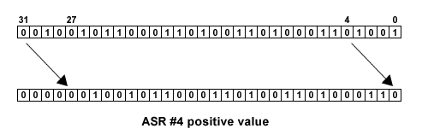
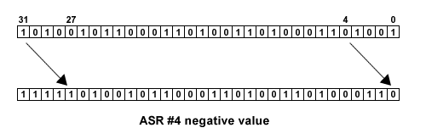
Arithmetic Shift Operations

Slide 30
Arithmetic Shift Operations
The 8-bit pattern for 112 is 0111 0000.
Performing LSR #3 or ASR #3 transforms the bit pattern to be 0000 1110 (or 14 which is 112 / 2^3).
Now what happens if the number is -112?
Create 2's complement bit pattern for -112 by flipping the bit pattern of 112 and adding 1:
0111 0000 becomes 1000 1111 + 1 becomes 1001 0000
An LSR #3 operation on 1001 0000 shifts the bits 3 places to the right and fills vacated bits with 0's
1001 0000 becomes 0001 0010 which is +18

Slide 31
Arithmetic Shift Operations
Now instead perform an ASR #3 operation on 1001 0000.
This shifts the bits 3 places to the right and fills the vacated bits with copies of the most significant bit, i.e. 1's.
1001 0000 becomes 1111 0010 which is -14.
Thus this ASR operation is equivalent to performing -112 / 2^3.

Slide 32
Rotate Operations
ROR (Rotate Right) behaves much like LSR in that bits are moved between 0 and 32 places to the right.
However, whereas the rightmost bits in a LSR operation fall off the register, in a ROR operation, these bits are used to fill the vacated slots at the most significant end of the register. In this way the bits "rotate".
If the degree of the rotation is 32 places, then the output is identical to the input as all the bits will have returned to their original location.

Slide 33
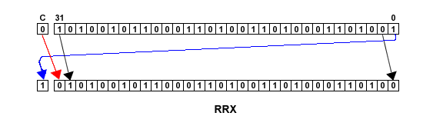
Rotate Operations
RRX is a ROR operation with a difference.
It rotates the number to the right by 1 place but the original bit 31 is filled by the value of the Carry flag and the original bit 0 is moved into the Carry flag.
Allows a 33-bit rotation by using both the register and the carry flag.
MOV r0, r0, RRX ; rotate right extended and put ; result back into r0

Slide 34
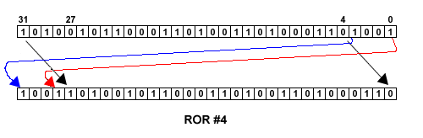
Rotate Operations
ROR can be used with a literal or by sourcing the rotation from a register.
MOV r0, r0, ROR #3 ; rotate value in r0 3 places and ; put result in r0
MOV r2, r0, ROR r1 ; rotate r0 by value of places in ; r1 and put result in r2

Slide 35
Flowcharts for Assembly Programs
Flow Charts are a graphical technique for designing short programs:
encourage design of the overall algorithm
independent of microprocessor architecture
easier to read than machine code
pen and paper good enough.
Flow charts work best when they can be drawn on a single page. Once a flow chart becomes too large for a single page, links from one page to another must be made consistently.

Slide 36
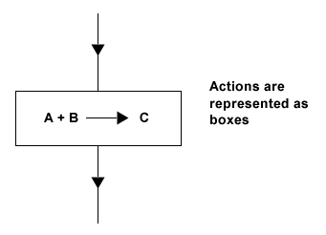
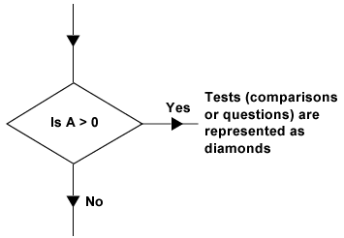
Flowcharts for Assembly Programs

Slide 37
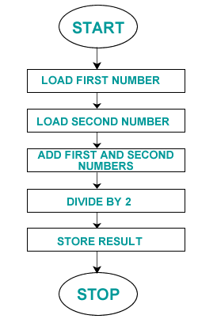
Example Program

Slide 38
Example Program
AREA Average, CODE, READONLY ; name code block
ENTRY ; marker of first executable instruction
start
ADR r1, FIRSTNUM ; load first address into r1
ADR r2, SECONDNUM ; load second address into r2
ADR r3, AVGRESULT ; load result address into r3
LDR r4, [r1] ; load first number into r4
LDR r5, [r2] ; load second number into r5
ADD r0, r4, r5 ; add numbers together
MOV r0, r0, ASR#1 ; divide by two using arithmetic shift
STR r0, [r3] ; store result to address pointed to by r3
SWI 0x11 ; terminate the program
END ; marks the end of the file

